Slide 1
Shepherding the Flock
A Lesson Submitted by Rev. Kevin T. Taylor
Pastor, Israel A.M.E. Church, Albany, NY

Slide 2
Edifying a “Transitioning Church” by raising awareness of:
Biblical Examples of Shepherds
1
Sheep Needs and Shepherd Responsibilities
2
AIMS
Shepherd Needs and Sheep Responsibilities
3
The Good Shepherd and Sacrificial Lamb
4

Slide 3
Pastors, what are your top three expectations for the sheep of your flock?
_{Great}
_{Expectations}
Laity, what are your top three expectations for the shepherd of your flock?
_{#1}
_{#3}
_{#2}

Slide 4
Biblical Examples of Shepherds
Example | Scripture | Example | Scripture
Abel | Genesis 4:2 | Jacob’s Sons | Genesis 47:3
Abraham | Genesis 21:28 | Moses | Exodus 2:17
Lot | Genesis 13:5 | David | 1 Samuel 17:34-36
Isaac | Genesis 26:12-15 | Mesha | 2 Kings 3:4
Jacob | Genesis 30:32 | Amos | Amos 1:1
Rachel | Genesis 29:9 | Of Jesus’s Birth | Luke 2:8-20

Slide 5
_{Authenticity}
_{A Helping Hand}
_{Connection}
Sheep Needs and Shepherd Responsibilities

Slide 6
A HELPING HAND
Sheep can’t right themselves if they’re on their back
These sheep, called “cast sheep” need a helping hand from the shepherd
Thought to Remember: Those who are cast aside by society need the focus of the shepherd and flock

Slide 7
AUTHENTICITY
Sheep have an excellent sense of smell
Sheep have scent glands in front of their eyes and between the digits of their hooves that produce smelly secretions used to communicate with one another
Thought to Remember: Sheep have an appreciation for when their shepherd is sincere. Is your congregation seeing the genuine YOU?

Slide 8
CONNECTION
Sheep do not remain in flocks simply for protection from predators
Sheep form strong bonds with one another, such as those between a mother and her lamb, and other friendships
Studies have revealed that sheep can distinguish between different emotional expressions

Slide 9
CONNECTION CON’T
This is a very important skill for sheep to have, as knowing how other sheep are feeling is the basis for forming strong social relationships and keeping the flock safe
Thought to Remember: How are you connecting with your flock on a personal level? Are you calling, visiting, texting/writing them? Celebrating their milestones, mourning their losses?

Slide 10
“BREAK” EVERY CHAIN
_{Being}
_{Change Adverse}
_{Wasting Time}
_{Being Insular}
_{Being}
_{Lukewarm}
Having meetings without agendas
“Taking turns” honoring members for Women’s Day, Men’s Day, and other special days
“That’s the way we’ve always done it”
Unwelcoming to visitors, new members
Shepherds can help the sheep “break” bad habits, such as the ones above

Slide 12
Pastors, what are your top three expectations for the sheep of your flock?
_{Great}
_{Expectations}
Laity, what are your top three expectations for the shepherd of your flock?
_{#1}
_{#3}
_{#2}

Slide 13
Paradigm Shift
“The handing down of information, beliefs, and customs by word of mouth or by example from one generation to another without written instruction”
_{Tradition}
_{Expectation}
_{Tone Moderation}
_{Preference}
“to like better or best”
“a regulation or bylaw governing procedure or controlling conduct”
_{Rule}

Slide 14
_{Plan for the flock}
_{Listen for God’s Voice}
_{Grace}
Shepherd Needs and Sheep Responsibilities

Slide 15
LISTEN FOR GOD’S VOICE
Moses heard it in the burning bush
The shepherds of Luke 2 heard it “while they were keeping watch over their flocks”
Thought to Remember: Are you giving your shepherd the space to hear God’s voice?

Slide 16
PLAN FOR THE FLOCK
In the springtime there is an abundance of green pasture, and usually the sheep are allowed to graze near to the village where the shepherd's home is located
After the grain is reaped, the sheep feed on certain fresh growths, or dried blades, or an occasional ear of grain that the reapers may have left or was overlooked by the gleaners
When this source of food is exhausted then the pasture is sought in other places

Slide 17
PLAN FOR THE FLOCK CON’T
In the late autumn or winter months, there are times when the shepherd can find no pasturage that is available for his flock, and then she/he must become responsible for feeding the animals themselves
Thought to Remember: Are you enabling your shepherd an opportunity to see the moves of God (e.g., Sermons, Bible Studies, ministry opportunities, social action impact, etc.) and to help the flock to meet God there?

Slide 18
GRACE
Quote from an actual sheepherder:
“Shepherds must be willing to be humbled daily. If there is any one thing that can bring you to your knees, it is shepherding. There will be days when you make the wrong decision, when you overlook the obvious, when the not so obvious will attack and leave you on your knees. If ever you thought you knew it all, forget it! There will always be days when you realize there is much yet to learn.”
Thought to Remember: Are you praying for your pastor and their family? Are you extending grace in their shortcomings and celebrating their successes?

Slide 20
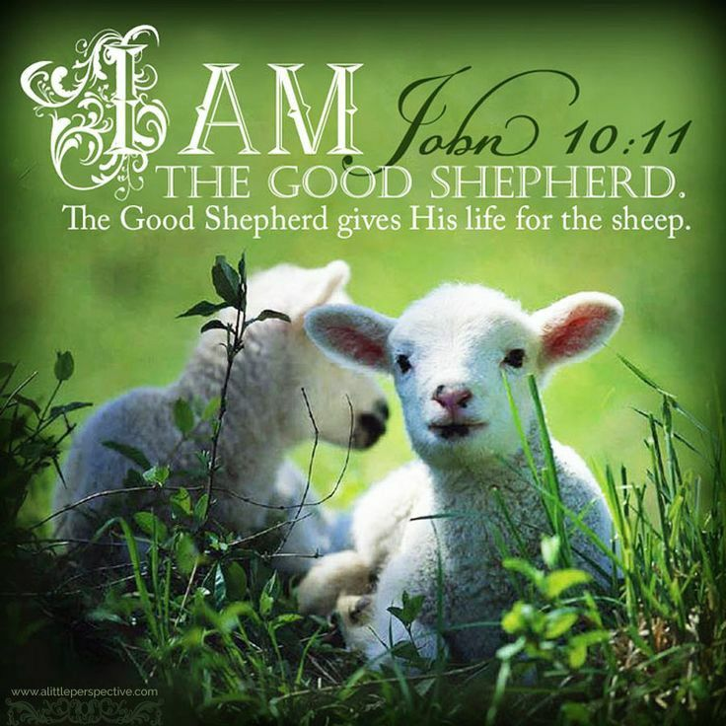
REMEMBER JESUS

Slide 21
Thank You!
Rev. Kevin T. Taylor, Pastor, Israel AMEC – Albany (323) 509-8706 (cell) | revkttaylor@hotmail.com

