Slide 1
To Serve with Integrity and Strive for Excellence…
Put Down the Duckie!
A Lesson submitted By Rev. Kevin T. Taylor
Pastor, Israel A.M.E. Church, Albany, NY

Slide 2
To Serve with Integrity and Strive for Excellence…
Put Down the Duckie!
Review Hebrews 12:1-2
1
Determine WHO is in your cloud
2
Decide WHICH duckie(s) you
need to put down
3
Define WHAT you are focused on
4

Slide 3
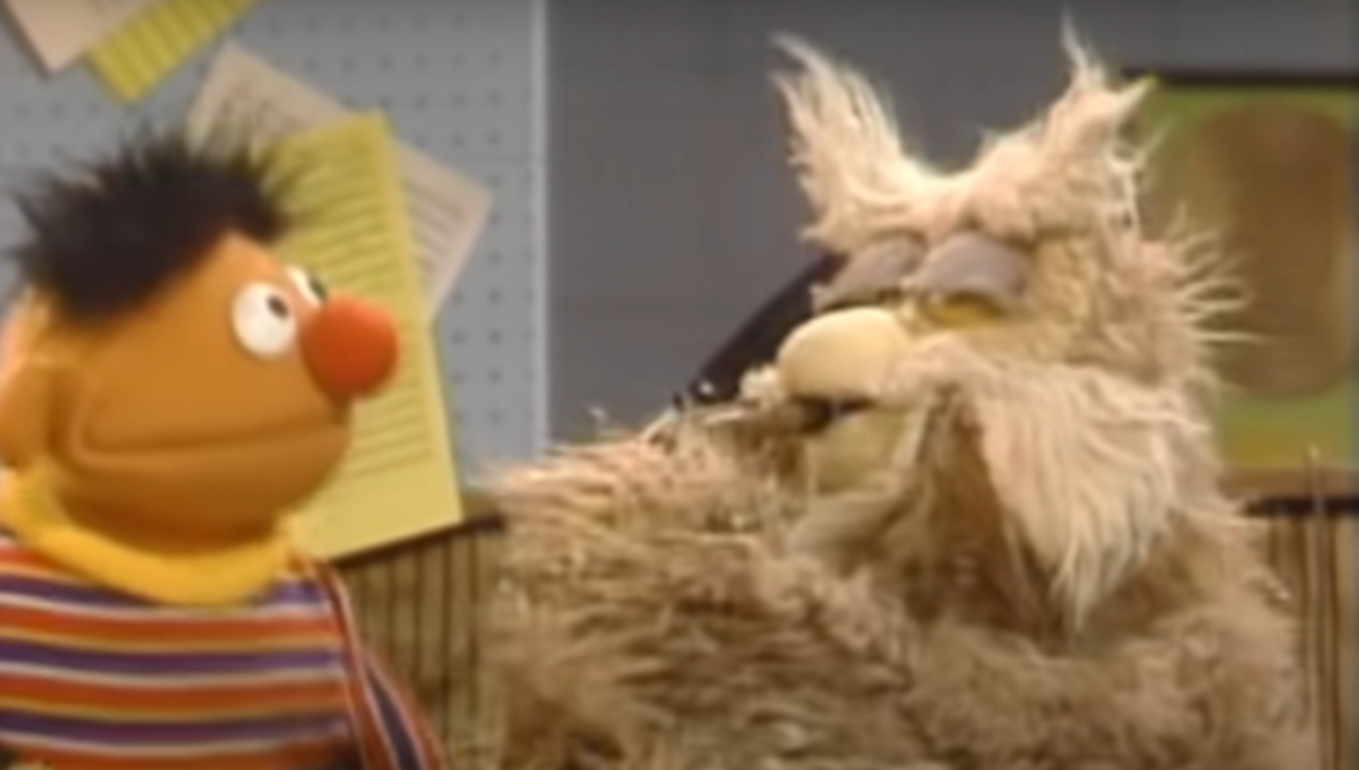
My friend, Ernie, sought help from “Mr. Hoots”

Slide 4
Other friends need help, too!
The A.M.E. Church wishes to remain relevant in its third century of ministry – and avoid being like the Church at Ephesus described in Revelation 2:1-7. What should it do?
The Episcopal District wants to become “A Transitioning Church” as referenced in Isaiah 43:19. What should it do?
The Local Church desires to attract and retain youth and young adults. What should it do?
The Laity seek to “Serve with Integrity, Strive for Excellence.” What should they do?

Slide 5
Hebrews 12:1-2 (NIV)
“Therefore, since we are surrounded by such a great cloud of witnesses, let us throw off everything that hinders and the sin that so easily entangles. And let us run with perseverance the race marked out for us, fixing our eyes on Jesus, the pioneer and perfecter of faith. For the joy set before him he endured the cross, scorning its shame, and sat down at the right hand of the throne of God.” (emphasis mine)

Slide 6
To Serve with Integrity and Strive for Excellence…
Put Down the Duckie!
_{Hebrews 12:1-2}
_{The Cloud}
_{The Focus}
_{The Duckie}

Slide 7
“a great cloud of witness”
To understand this, we need to look at the previous chapter, as evidenced by the word therefore beginning chapter 12.
Abraham, Isaac, Jacob, and the rest of the Old Testament believers looked forward with faith to the coming of the Messiah.
The author of Hebrews illustrates this eloquently in chapter 11 and then ends the chapter by telling us that the forefathers had faith to guide and direct them, but God had something better planned.
Then he begins chapter 12 with a reference to these faithful men and women who paved the way for us.
For more info, visit https://www.gotquestions.org/cloud-of-witnesses.html

Slide 8
“a great cloud of witness” (con’t)
It’s not that the faithful who have gone before us are spectators to the race we run.
Rather, it is a figurative representation and means that we ought to act as if they were in sight and cheering us on to the same victory in the life of faith that they obtained.
We are to be inspired by the godly examples these saints set during their lives.
That the cloud is referred to as “great” indicates that millions of believers have gone before us, each bearing witness to the life of faith we now live.
For more info, visit https://www.gotquestions.org/cloud-of-witnesses.html

Slide 9
WHO is in your cloud?
Take a moment to think about your answer. Next, turn to the people in your row to learn how they answered. Are there similarities and/or differences in your responses?

Slide 10
To Serve with Integrity and Strive for Excellence…
Put Down the Duckie!
_{Hebrews 12:1-2}
_{The Cloud}
_{The Focus}
_{The Duckie}

Slide 11
“throw off everything that hinders” (NIV)
_{Strip/Stripping}
_{NLT}
_{AMP}
Put Down
The Duckie
_{Lay Aside}
_{KJV}
_{ESV}
_{NKJV}
_{Rid us/ourselves}
_{NASB}
_{NIV}

Slide 12
WHICH duckie(s) do you need to put down?
Take a moment to think about your answer. Next, turn to the people in your row to learn how they answered. Are there similarities and/or differences in your responses?

Slide 13
To Serve with Integrity and Strive for Excellence…
Put Down the Duckie!
_{Hebrews 12:1-2}
_{The Cloud}
_{The Focus}
_{The Duckie}

Slide 14
“fixing our eyes on Jesus”

Slide 15
WHAT are you focused on?
Take a moment to think about your answer. Next, turn to the people in your row to learn how they answered. Are there similarities and/or differences in your responses?

Slide 16
To Serve with Integrity and Strive for Excellence…
Put Down the Duckie!
_{Hebrews 12:1-2}
_{The Cloud}
_{The Focus}
_{The Duckie}

Slide 17
https://youtu.be/acBixR_JRuM

Slide 19
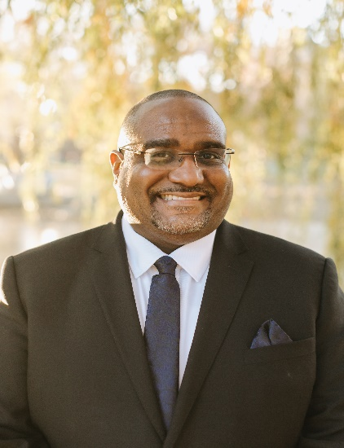
Thank You!
Rev. Kevin T. Taylor Pastor, Israel AMEC – Albany (323) 509-8706 (cell) | revkttaylor@hotmail.com

