Slide 1

ELECTION 20__ – CAN WE MAKE A DIFFERENCE WITH
AMEV-ALERT? YES WE CAN!!
Today, we are ___ days before Election Day on November ___. VOTING is our highest priority.
We gather to PROTECT the quality of life. We EMPOWER ourselves with knowledge to share.
We leave to PROTEST anything that would endanger lives & HUMANITY.
We STAND, even if we must stand alone.

Slide 2
YES WE CAN
WWW.AMEV-ALERT.ORG
PLAN OF ACTION: 10-10-10 =1,000

Slide 3
Let us pray!
Let us walk together… then envision anew!
What is the CALL upon us?
What works for you… your church… your annual conference… your community?
Who is called to work with us?
Who might oppose us? We move out building upon the strong influence and rich inheritance which could only lead us to act with “integrity” in all things so that “those who oppose (us) may be ashamed because they have nothing bad to say about us.” (Paraphrased from Titus 2:7).
How will we know when our work is done?

Slide 4
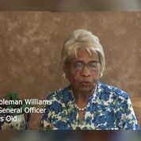
IT’S OUR WATCH!
“Arrogant lies make it difficult for democracy’s truths to prevail.” We must be truth tellers!!
ELECTION PROTECTION gives you a resource when SOMETHING IS NOT RIGHT UP TO AND ON ELECTION DAY 1-866-OUR VOTE (687-8683).
EDUCATE YOURSELF. Use www.amev-alert.org for Toolkit.
Then share with your TEAM CAPTAINS & LEADERS
Make it your “small talk” wherever you are; whoever you text; when you post; in everything that you do.

Slide 5
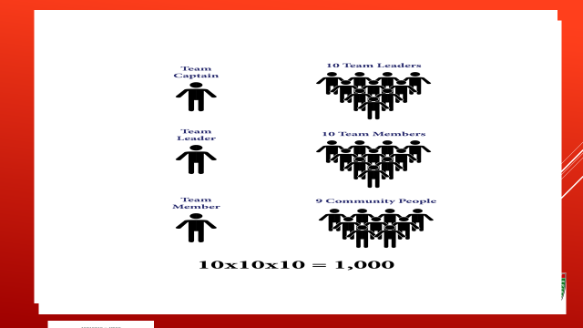
AMEV-Alert is committed to bringing BEST practices to the work. This model is adapted from years of use to increase the voter turnout. Thank you to all who, by using the model, have been a part of making it better.

Slide 6
Responsibilities of a Team Captain:
The Team Captain will identify 10 people to be Team Leaders (gathering name, phone and email address). Keep list close by for daily contacts. Please see attached Team Captain form.
The Team Captain will only manage those 10 Team Leaders.
Add email addresses
The Team Captain will check in with their Team Leaders every day or every other day, keeping in direct communication, encouraging them to put their lists together within the first week.
Create a V-Alert Folder on their computer with sub-folders for:
  Voting Photos (with sub-folders for each of their Team Leaders)
  Rosters
  Training Materials – re ballot initiatives and 10-10-10 model.
Team Captains will forward Team Member voting photos to the Lay Organization Episcopal District Coordinator as they are received from their Team Leaders.

Slide 7
___ Episcopal district connectional lay organization
ELECTION
WARRIORS
Episcopal Districts
1
2
3
4
5
6
7
8
9
10
11
12
13
14
15
16
17
18
19
20

Slide 8
Connectional lay organization
COMMUNITY
PARTNERS
FAITH BASED
CIVIL RIGHTS, CIVIC, COMMUNITY

Slide 9
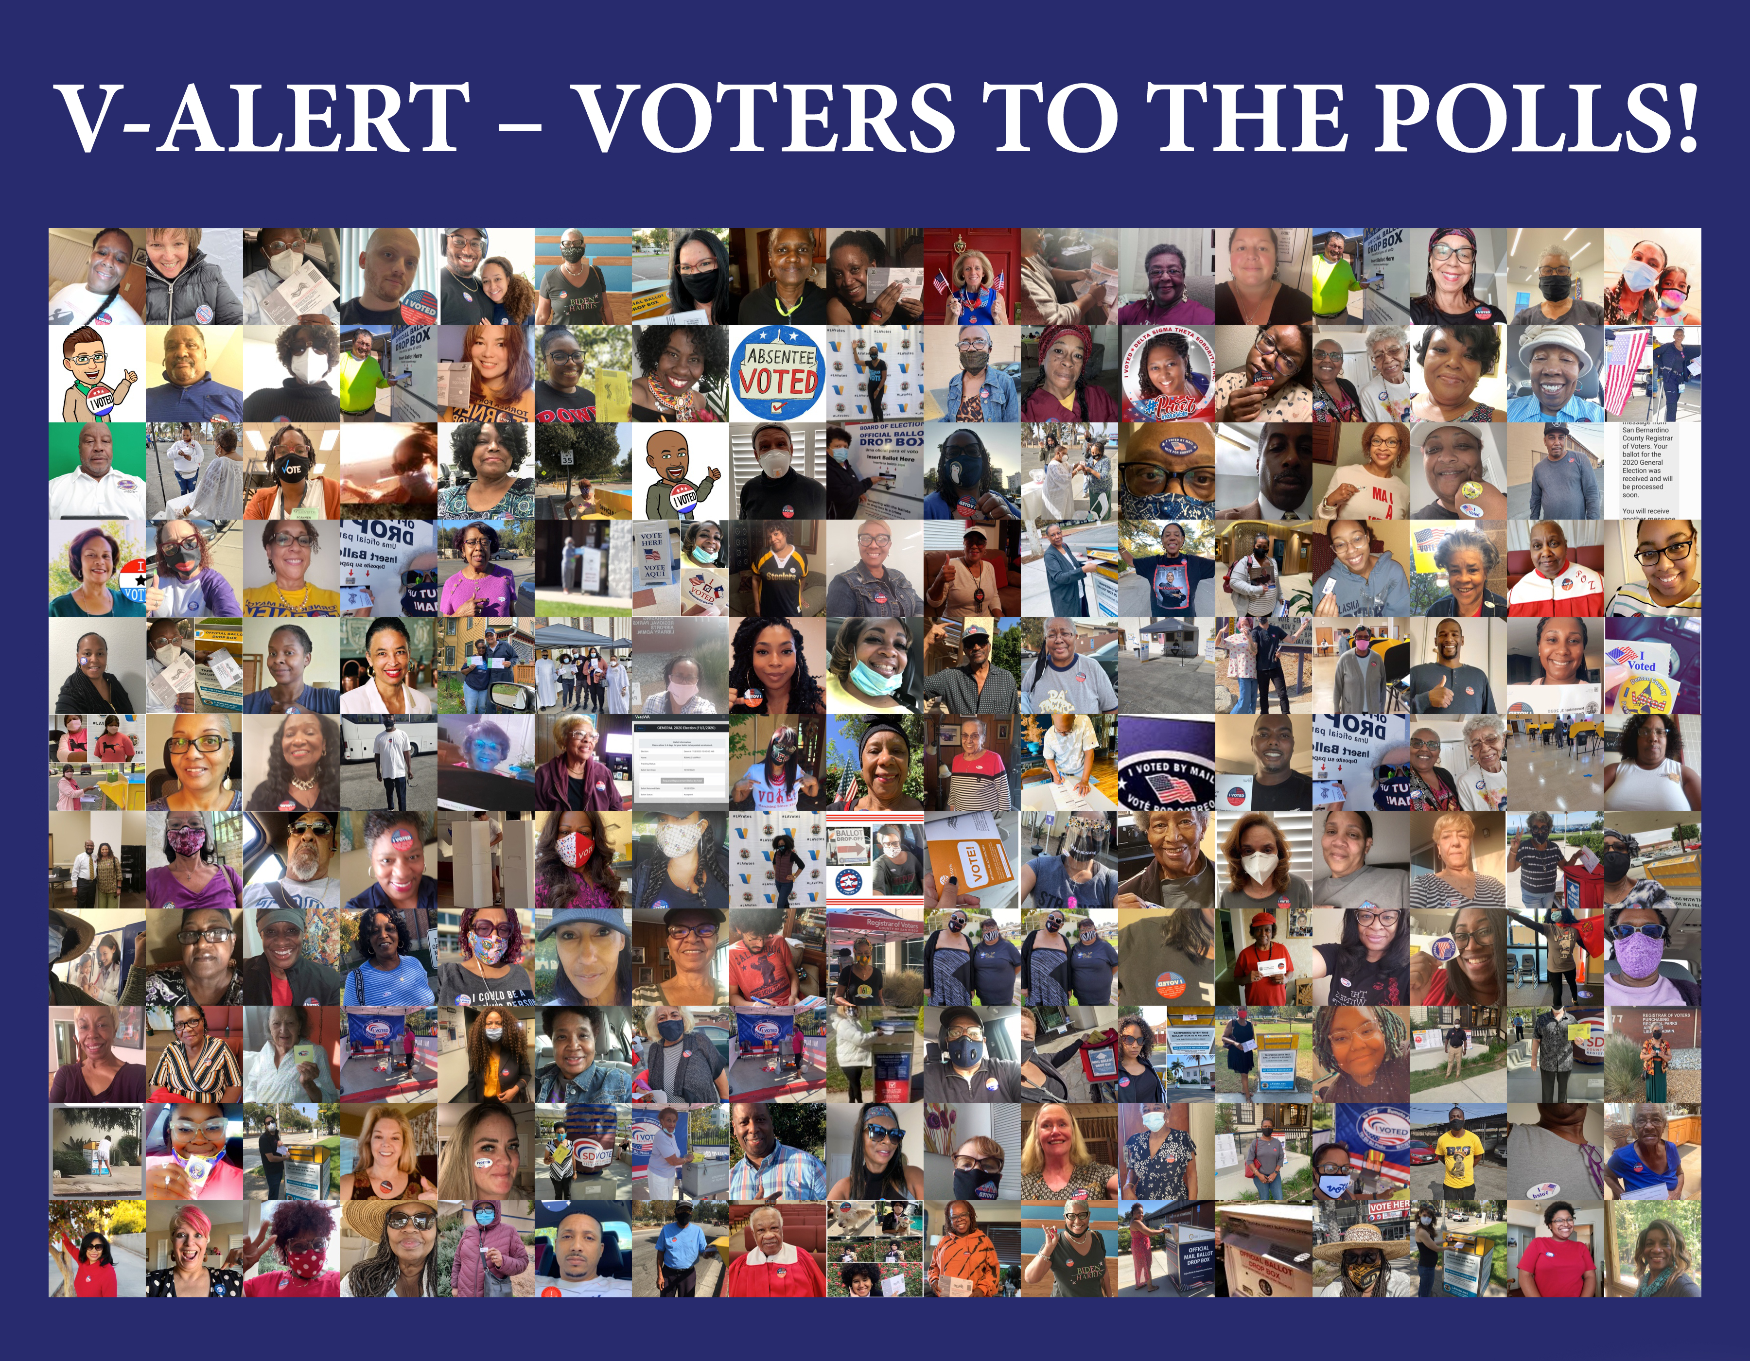

Slide 10
GETTING READY: VOTER INFORMATION AND GUIDANCE RELATING TO COVID-19
COVID19 conditions may encourage voters to stay at home and vote by their mail-in ballot. Although, this election will very likely offer in-person voting, most will strictly follow the public health and safety guidelines to ensure we provide a safe voting environment.
COVID-19 Information for Voting In-Person:
Voters should wear a clean face-covering when visiting the Vote Center
Election Workers will be wearing protective gloves and masks
Social distancing will be enforced at the check-in and voting process
The Ballot Marking Devices will be sanitized after every voter
Gloves will be provided to voters upon request

Slide 11
It’s up to us!
WHAT?
Election Warriors
Virtual Orientation sessions
Ambassador Sign Up
Election Countdown
  WHO?
Connectional Lay Organization
Episcopal District commitment
Find Partners (civil rights, interfaith, community)

Slide 12
CALLED TO ACTION: Jacquelyn dupont-walker, chair – amev-alert committee
Please meet this native Floridian (11th District) who has resided in Los Angeles, CA (5th District) for 45 years. “Jackie” is the youngest of 5 children born to Rev. King Solomon and Mrs. Eleanor Jiles Dupont. She is recently widowed after 43 years and 5 months of marriage to Buford “Sonny” Walker. Their blended family includes eight adult children with grands and great grands.
Her professional talents, and training in social work as MSW & LCSW have supported her called to faith based community development. For 35 years, Jacquelyn has served as President of Ward Economic Development Corp (WEDC).
Volunteering Spirit: By appointment, JDW serves as 2nd Vice Chair of LA Metro Board, member of Baldwin Hills Conservancy and Nate Holding Performing Arts Center boards.
FAITH WORK: Jackie is a 46-year member in good and regular standing and officer of Ward AME – Los Angeles. Her work in Lay Ministry is a blend of Social Justice and Community Service as Connectional Director of the Commission on Social Action. Her commitment to the legacy of Richard Allen led to founding AMEV-Alert in 1999. When “Jackie” is passionate, there are no barriers insurmountable nor horizons unconquerable.
Her reach is broad & diverse because she and God have already talked. “Jackie” thrives by creating viable communities and selflessly devoting skills and resources, utilizing networking as a strategy for creating strong linkages from a faith-centered perspective, mentoring new leadership, and encouraging institutional change that enhances the quality of life for all people.
SUMMARY: “God is in charge” of my life.
SISTAH “JACKIE”

