Slide 1
Welcome to
VITA - Colorado Tax Update
VITA/TCE & TaxSlayer

Slide 2
Your Facilitator
Martha Lewis
vita@ppunitedway.org
719-208-7414

Slide 3
Overview
Colorado Tax Updates
FATC (It’s new)
CTC
COEITC
Senior Housing Tax Credit
TABOR

Slide 4
What’s New For Colorado VITA
Family Affordability Tax Credit (FATC)
New refundable Colorado state tax credit – It’s NEW
Uses Colorado TABOR funds
Set to continue through 2033
A refundable, Colorado state tax credit for families with eligible children
Up to $3,200 per eligible child, 5 years or younger as of 12/31/24
Up to $2,400 per eligible child between 6 and 16 years of age as of 12/31/24
Tax credit varies based on how long you lived in Colorado in 2024
Parents with ITINs can receive the credit if eligible children have SSN
Amounts vary based on income levels, higher credit amounts for lower income levels

Slide 5
Colorado Child Tax Credit (COCTC)
State CTC - $200-$1,000 (no SSN required)
State CTC is refundable (means you could get a refund)
State CTC is only for children under 6

Slide 6
Colorado Earned Income Tax Credit (COEITC)
Colorado residents who claim federal EITC can also claim COEITC
ITIN filers can claim COEITC but not federal
COEITC is 50% of Federal EITC

Slide 7
Colorado Senior Housing Tax Credit
65+ Seniors who did not claim the Senior Homestead Property Tax Exemption (Property Tax Reimbursement)
Up to $800 based on AGI below $75K/$125K
Prorated for part-year residents

Slide 8
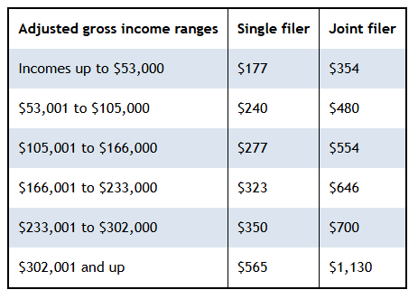
Colorado TABOR Refund
(Taxpayer’s Bill of Rights)
For full year Colorado residents who were 18 when the tax year began
Six tiers
Smaller than last year
Can be claimed using an ITIN (if the same as 2023)
Deadline is October 15 for all eligible taxpayers

Slide 9
Summary
Colorado Tax Updates
FATC (It’s new)
CTC
COEITC
Senior Housing Tax Credit
TABOR

Slide 10
Questions

