Slide 1
Clockify Training
How to log volunteer tutor time using Clockify
July 14, 2020
Sanjee Choudhuri

Slide 2
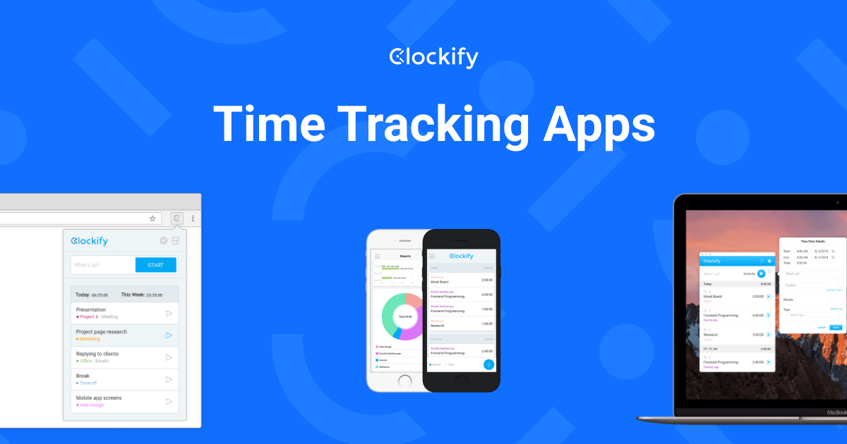
What is Clockify?
Clockify is an online time tracking platform!
Clockify can be accessed from your computer or mobile device
Literacy Chicago will be using Clockify to help track all the tutors wonderful work
We hope Clockify will make submitting hours easier for you and make collecting hours easy for us!

Slide 3
How to use Clockify!

Slide 4
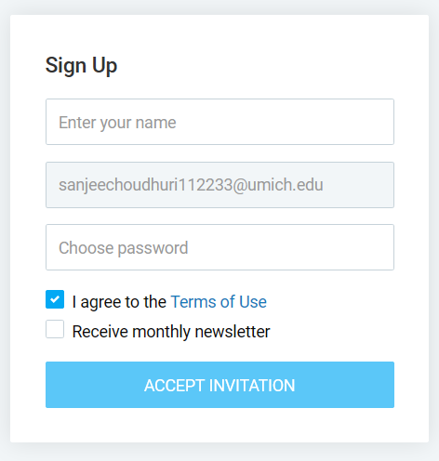
Signing Up
You should receive an email invitation to the Literacy Chicago Clockify
Click the link and fill out the required information to sign up!

Slide 5
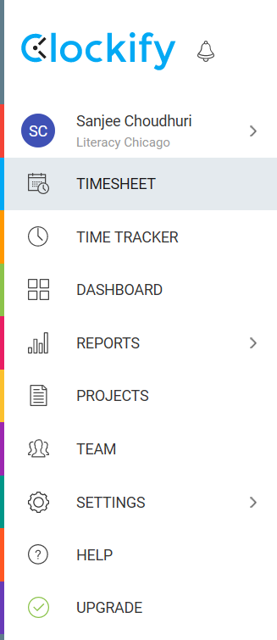
Navigating Clockify: Menu Bar
This is the Menu Bar you’ll use to navigate Clockify
The Menu Bar is located on the left side of the screen
For the time being, the only buttons you need to use are:
Timesheet (Dotted orange box)
Time Tracker (Dotted green box)

Slide 6
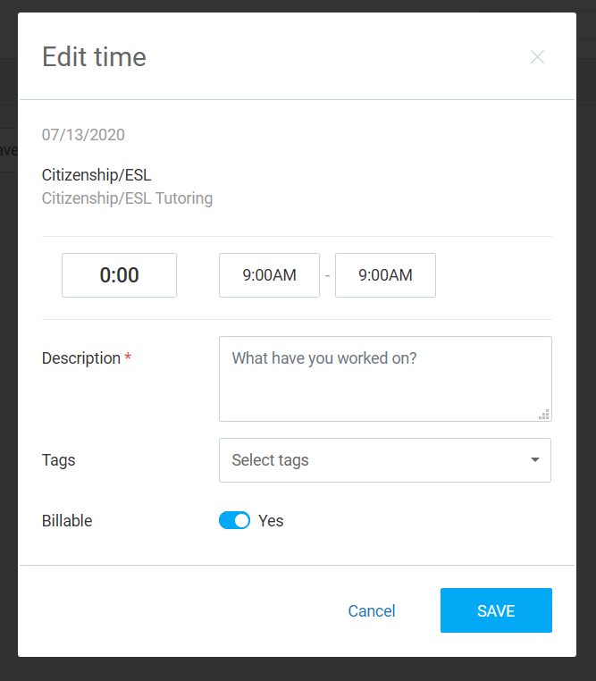
Entering Time: Timesheet (Easiest)
1
2
There are two ways to enter time in Clockify. The first way is through the timesheet.
To enter your time on the Timesheet follow these steps:
Select Project: This will be either your students name or your class name
Select Day: Click on the timeslot under that day you tutored
Enter Time: Select the start and end time you were tutoring
Enter Description: Add a description of what the tutoring sessions consisted of (ex. Two Digit Addition)
Click Save
3
4
5

Slide 7
Entering Time: Time Tracker (Harder)
There are two ways to enter time in Clockify. The first way is through the timesheet.
To enter your time on the Timesheet follow these steps:
Select Manual Entry: There are two options, timer or manual entry. The bottom button is manual entry
Enter Description: Add a description of what the tutoring sessions consisted of (ex. Two Digit Addition)
Select Project: This will be either your students name or your class name
Enter Time: Select the start and end time you were tutoring
Select Day: Click on the timeslot under that day you tutored
Click Add
2
3
4
5
1

Slide 8
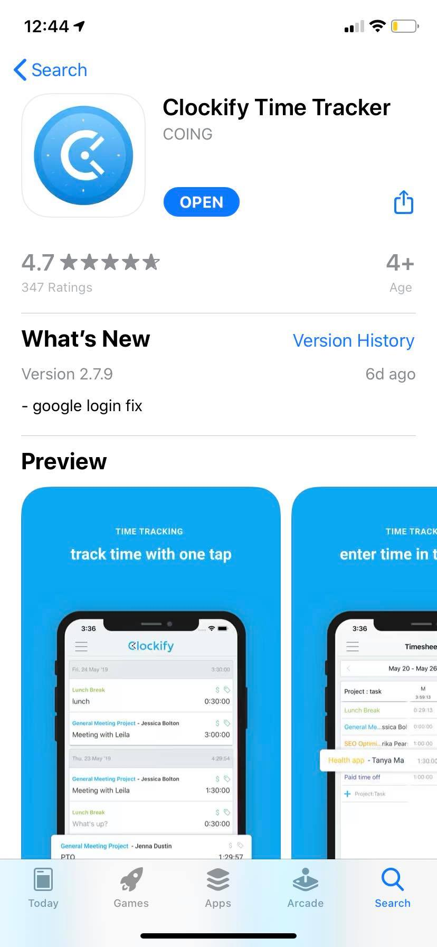
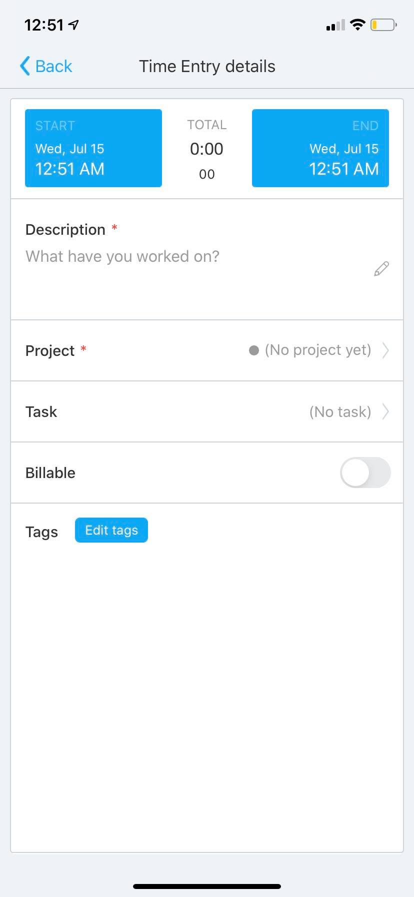
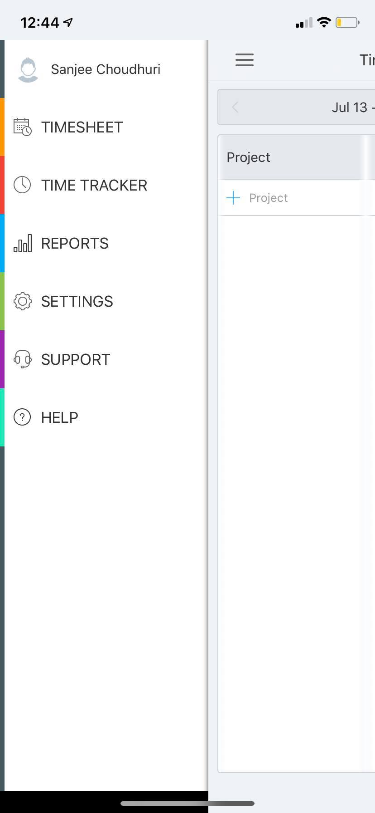
Entering Time: Mobile
Clockify also has a mobile app for iPhone and Android
The Menu Bar and functionality are almost exactly the same as on the computer
We recommend you download the app, so you can enter time immediately after a tutoring session!

Slide 9
Questions?
How often should I enter my time?
Immediately after tutoring! Download the App on your phone for easy access.
What if I enter my time wrong?
You can edit your time entries
Help! I forgot my password!
Use the “Forgot Password?” button to reset it!
I never got the sign-up email. What gives?
Send an email to Joanne and we’ll get that sorted away
Notes:
Questions
Help Page

